Slide 1
Approximation and Visualization of 3D Objects
Engineering Project 1
Povilas Simanaitis IFM-8

Slide 2
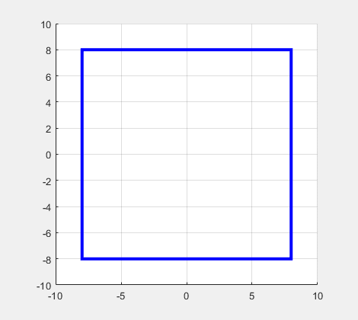
Solution for problem #1
Part of solution
Result
function[x, y]=calculaNewCircle(x, y, dx, dy, t)
[x, y] = transform(x,y, shift(dx, dy));
[x, y] = transform(x,y, rotate(dx, dy, t*4));
if(t > 10.75 && t < 13 || t > 47.75 && t < 50 )
[x, y] = transform(x,y,scale(dx, dy, 0.185));
end
if ( t > 28.5 && t < 30.5 )
[x, y] = transform(x,y,scale(dx, dy, -0.185));
end
end
P170M103
Notes:
Pakomentuoti transform -0.185

Slide 3
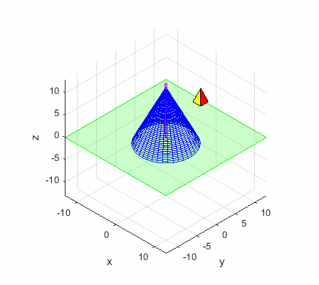
Solution for problem #2
Pyramid was constructed from 4 planes
Transformations applied for each plane
Shift and rotate animations were used
Cone tumbling has been implement like this
cone = surf(X, Y, (Z+5)./(1+(10*t/500) , ... );
P170M103

Slide 4
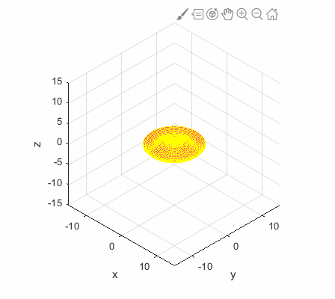
Solution for problem #3
for t=1:100
[nX,nY,nZ] = transform(X,Y,Z,scale(1+(t/100)));
[nX,nY,nZ] = transform(nX,nY,nZ,rotate(t*3));
object = redraw(object, nX,nY,nZ, true);
end
for t=1:100
[nX,nY,nZ] = transform(nX,nY,nZ,rotateVertical(1/100*pi));
object = redraw(object, nX,nY,nZ, true);
end
[X,Y,Z] = transform(X,Y,Z,rotateVertical(pi));
for t=1:100
[nX,nY,nZ] = transform(X,Y,Z,scale(2-(t/100)));
[nX,nY,nZ] = transform(nX,nY,nZ,rotate(-t));
object = redraw(object, nX,nY,nZ, false);
end
P170M103
Notes:
[X,Y,Z] = transform(X,Y,Z,rotateVertical(pi));

Slide 5
Transform functions used solutions
Problem #1
Problem #1
Problem #1
function [X, Y] = transform(x,y,T)
t = ones(1, length(x));
A1=T*[x;y;t];
X=A1(1,:);
Y=A1(2,:);
end
function [X,Y,Z] = transform(x,y,z,T)
t = ones(1, length(x));
A1 = T*[x;y;z;t];
X = A1(1,:);
Y = A1(2,:);
Z = A1(3,:);
end
function [X,Y,Z] = transform(X,Y,Z,T)
XYZ=[reshape(X,1,prod(size(X)));
reshape(Y,1,prod(size(Y)));
reshape(Z,1,prod(size(Z)));
ones(1,prod(size(Z)))];
A1 = T*XYZ;
X = reshape(A1(1,:),size(X));
Y = reshape(A1(2,:),size(Y));
Z = reshape(A1(3,:),size(Z));
end
P170M103

Slide 6
Things I learned while doing this
Animating incrementally, instead of always animating from iniatial position, reduces transformations needed, but can posible complicate some calculations, such as scaling untill oibject size doubles.
When if object is „flipped“, one has to also invert transformation matrix used with it, otherwise transformation will „unflip“ object.
Sometimes one can avoid using transformations (cone tumbling example).
Recording to gif makes whole animation slower, probably because of the load machine receives.
P170M103

